Slide 1
NVivo ResPitch
Alex Shermon | Research Computing Services The University of Melbourne

Slide 2

NVivo Workshops on Github
Make sure to consult the README first for installation instructions
NVivo ResPitch (is this tool for you?)
Introduction to Nvivo
Intermediate Nvivo Workshop
Link to Repository

Slide 3

What will you learn in this presentation?
In this lab, you will learn the very basics of NVivo:
What is NVivo?
How to import files into NVivo
How to code those files
Is NVivo right for my research>
Ben White (https://unsplash.com/photos/qDY9ahp0Mto)

Slide 4
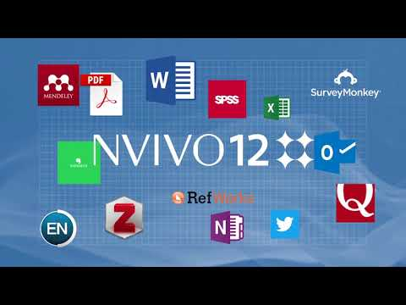
What is NVivo?
Computer Assisted Qualitative Data Analysis Software developed by QSR International.
NVivo offers 3 key functions:
Store and Organise
Categorise and Analyse
Visualise and Discover
NVivo 12 Overview by NVivo by QSR, 2018
Check out their site

Slide 5
Is NVivo the right tool for you?
NVivo helps to manage Qualitative and Mixed Methods research data:
Literature Reviews
Thematic Analysis
Textual Analysis
NVivo is not designed for:
Large scale content analysis
Natural language analysis
Long-term research data management

Slide 6

Importing Files in NVivo
Maksym Kaharlytskyi (https://unsplash.com/photos/Q9y3LRuuxmg)

Slide 7

DEMO: Importing Files into NVivo
Windows - Importing with NVivo 12 (Windows), NVivo by QSR 2018
Mac - Importing with NVivo 12 Mac, NVivo by QSR 2018

Slide 8

Challenge: Import Files into NVivo
Create a folder for “Interviews”
Import files from the Github repository:
Barbara, Charles, Dorothy, Margaret, Maria and Daniel, Mary and James
Erol Ahmed (https://unsplash.com/photos/Y3KEBQlB1Zk)

Slide 9

2. Coding Files in NVivo
Aaron Burden (https://unsplash.com/photos/Hzi7U2SZ2GE)

Slide 10
What is Coding?
“In qualitative research, a procedure by which raw data, often but not always in the form of elicited speech which has been recorded in some way, are transformed into meaningful and theoretically meaningful categories.”
“In quantitative research, the process of categorising data from open-ended questions”
Sage Research Methods

Slide 11
Coding in NVivo
Windows - Coding in NVivo 12 Windows, NVivo by QSR 2018
Mac - Coding in NVivo 12 Mac, NVivo by QSR 2018

Slide 12

Challenge: Code Files in NVivo
Create nodes for “community” and “economy”
Drag and drop text into these nodes
Rinse and repeat!
Nodes are like containers for your coded data
Guillaume Bolduc (https://unsplash.com/photos/uBe2mknURG4)

Slide 13
Conclusion: Is NVivo For You?

Slide 14
Is NVivo for You?
File management and coding are the most common activities that you will be doing as a researcher in NVivo.
If you can’t see NVivo being useful for answering your research question, that’s okay! It’s not for everyone.
However, if you are doing qualitative or mixed-methods research, or research activities like a literature review, then NVivo can be a great research assistant!
Remember, NVivo does not do your research for you, you will still have to do a lot of analysis yourself. It just makes it a bit easier, like your own Research Assistant!

Slide 15

What Have we Learnt Today?
What NVivo Is
How to import files into NVivo
How to code files into NVivo
Whether NVivo is right for your research
Guille Álvarez (https://unsplash.com/photos/IcI3FizU9Cw)

Slide 16
Next Steps
Introduction to NVivo
You will go over coding and importing again, but framed within broader research methodology. You will learn the importance of cases and case classifications, as well as how to create a word cloud.
Any questions?
Get in touch with me at alex.shermon@unimelb.edu.au Follow me on twitter @alexshermon Subscribe to the NVivo Community Newsletter: http://eepurl.com/gExj6f

